Slide 1

Five Thirty Fun

Slide 2

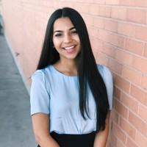
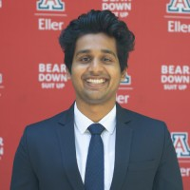

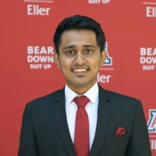


Meet the Team
Akshita Badola
Arjun Gopalakrishnan
Rachel Heusser
Sujay Idagunji
Srujan K S
Gaurang Parulekar

Slide 3
Agenda
What is UA Campus Pantry?
Business Needs
Conceptual Design
Relational Design
SQL Queries
Triggers & Procedures
Front-End Demo
Q&A

Slide 4
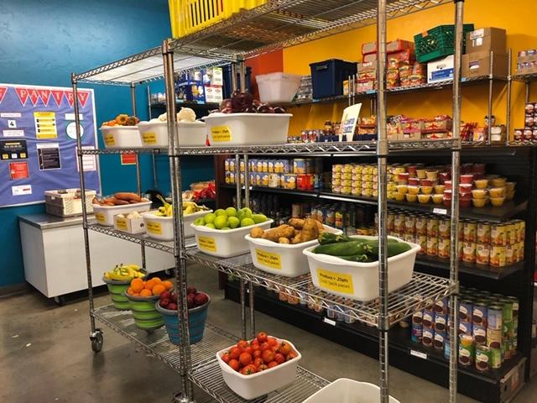
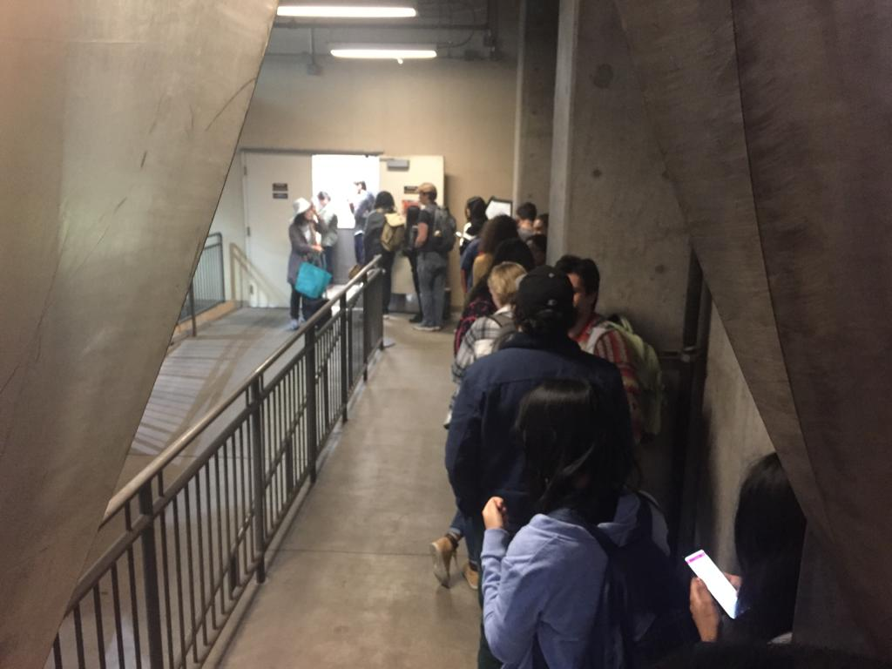
What is UA Campus Pantry?
The goal of the UA Campus Pantry is to reduce food insecurity in our Wildcat Community.
At our distribution events, students and staff can grab important food staples at no cost. All you need is your CatCard!

Slide 5

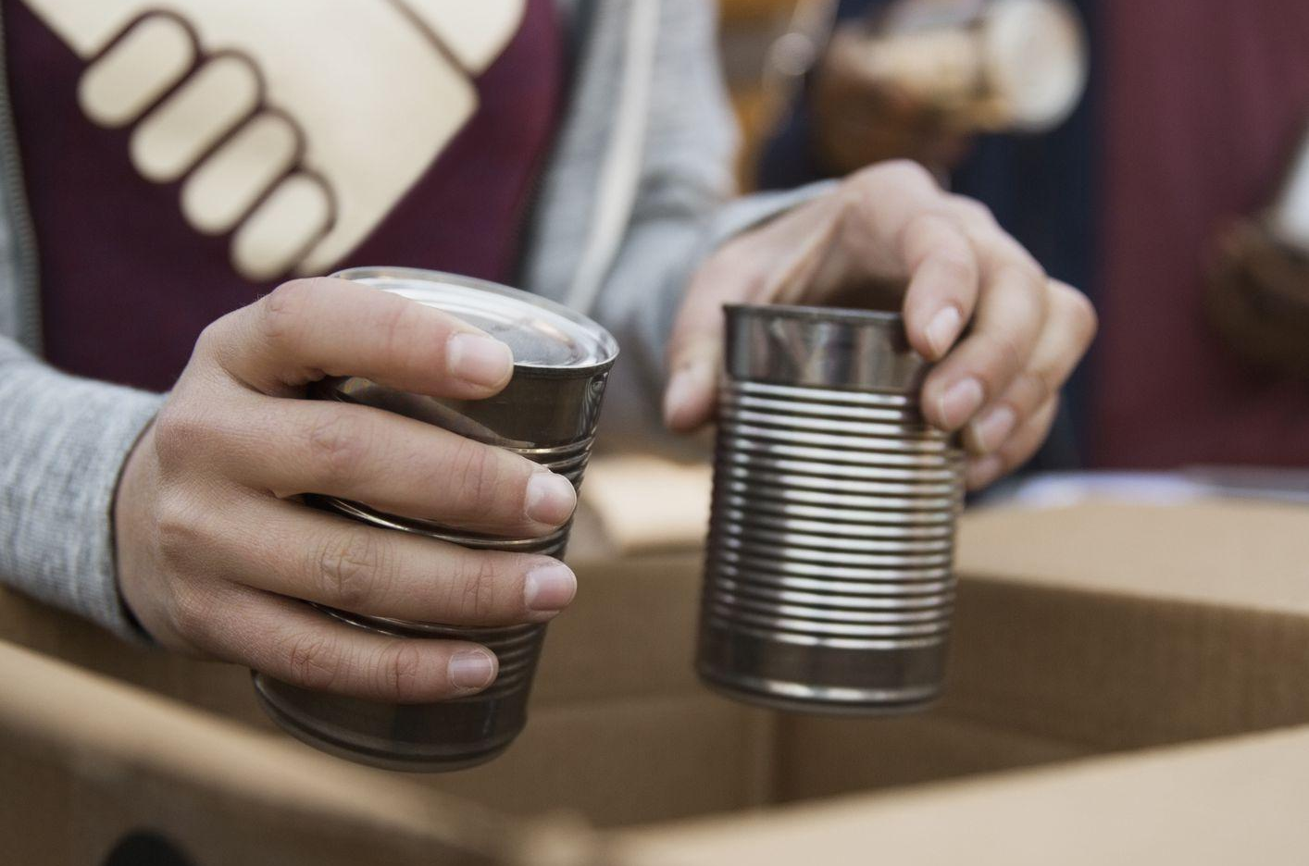
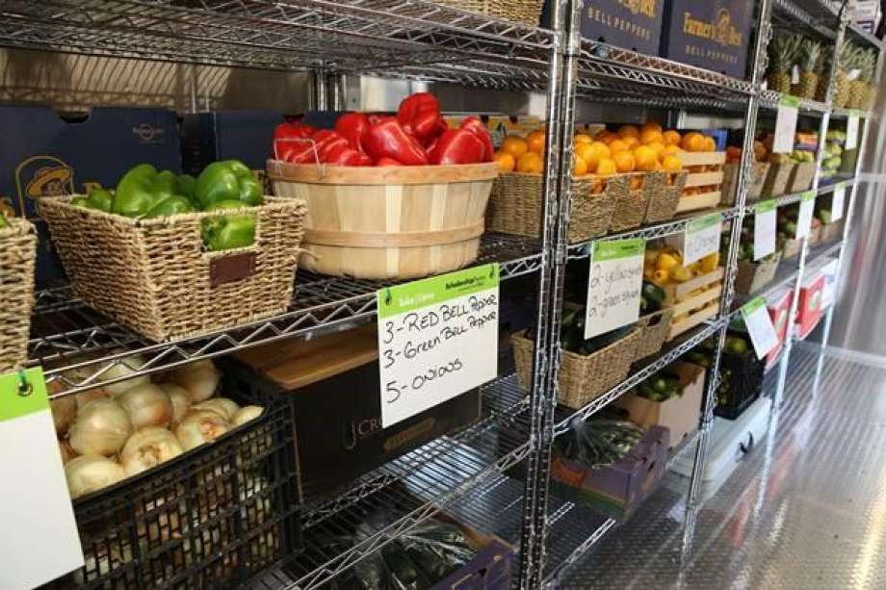

Business Needs
Student
Distribution
Attend weekly distribution hours
Choose fresh produce and non-perishables
Record weight of bags that students take
Purchase Orders & Donations
Weekly purchases from vendors
Individuals or Organizations
Monetary or Physical Items
Food in
Warehouses
Items recorded by weight
Items placed into warehouses
Transferred to pantry as needed
Employees &
Teams
Individual roles and responsibilities
Different roles needed in each team
Teams have shifts during distribution

Slide 6
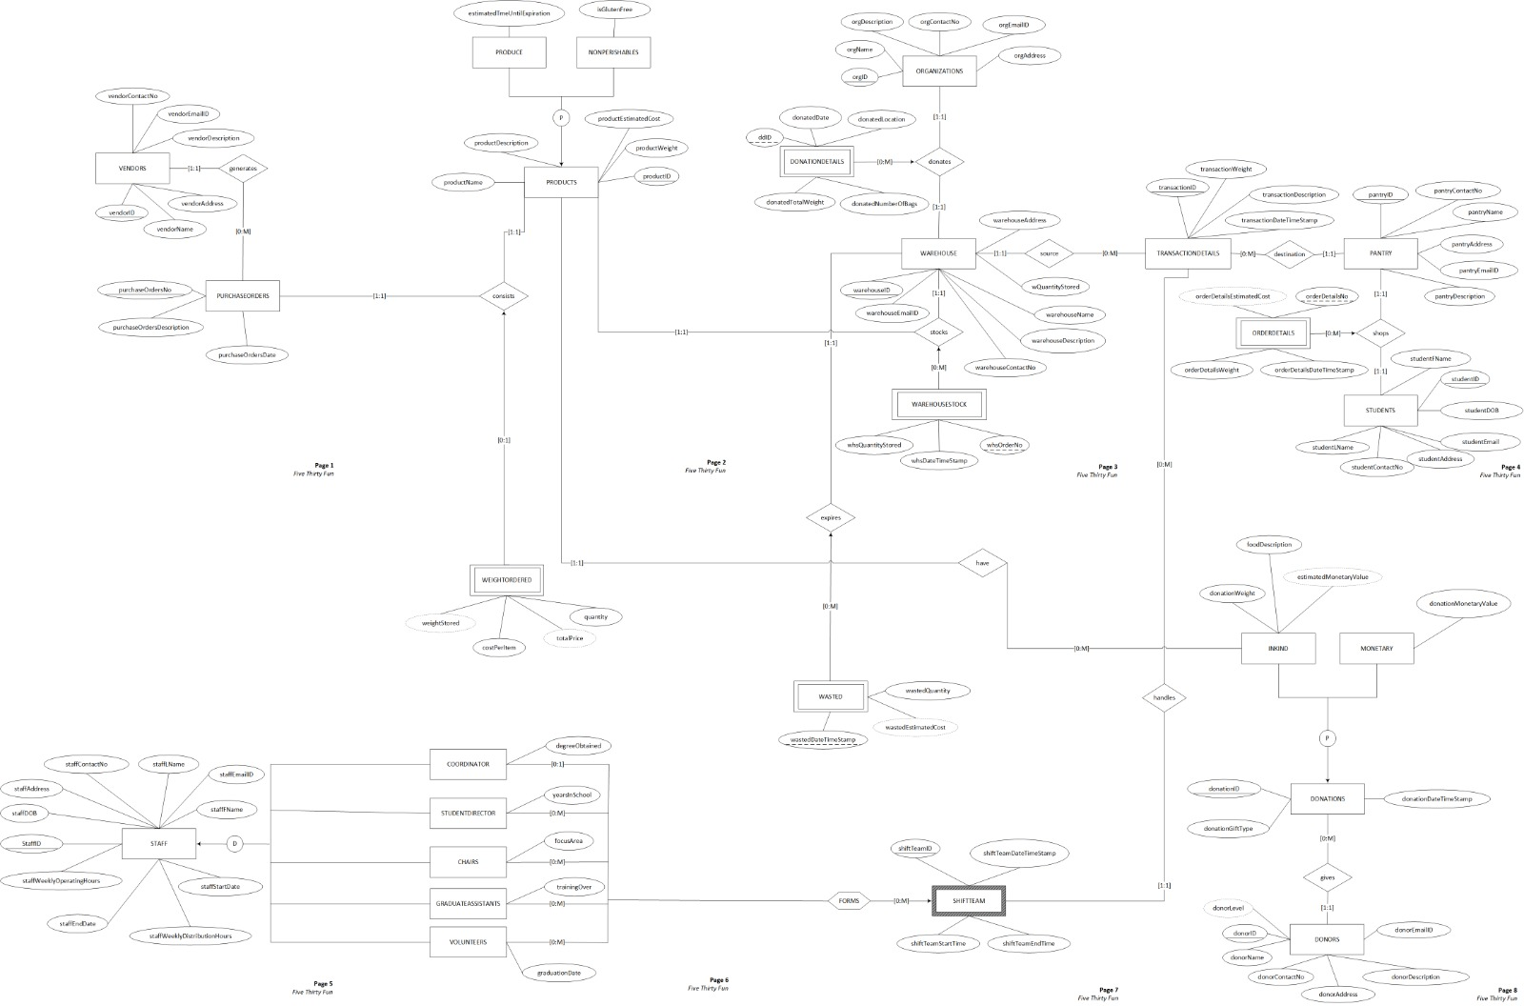
Conceptual Design (ER Diagram)

Slide 7
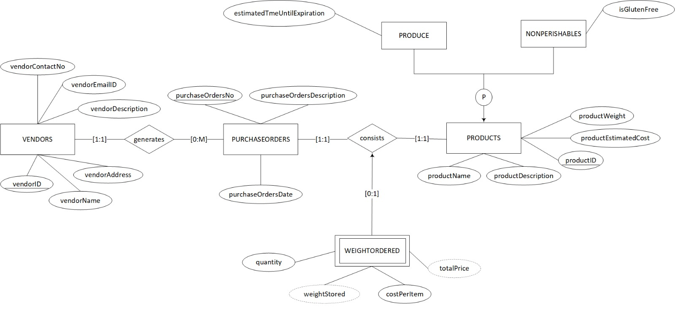
ER Diagram (continued)
VENDORS
VENDORS HAVE DIFFERENT PURCHASE ORDERS
ONE PURCHASE ORDER CAN HAVE DIFFERENT PRODUCTS
PRODUCTS CLASSIFIED IN 2 TYPES

Slide 8
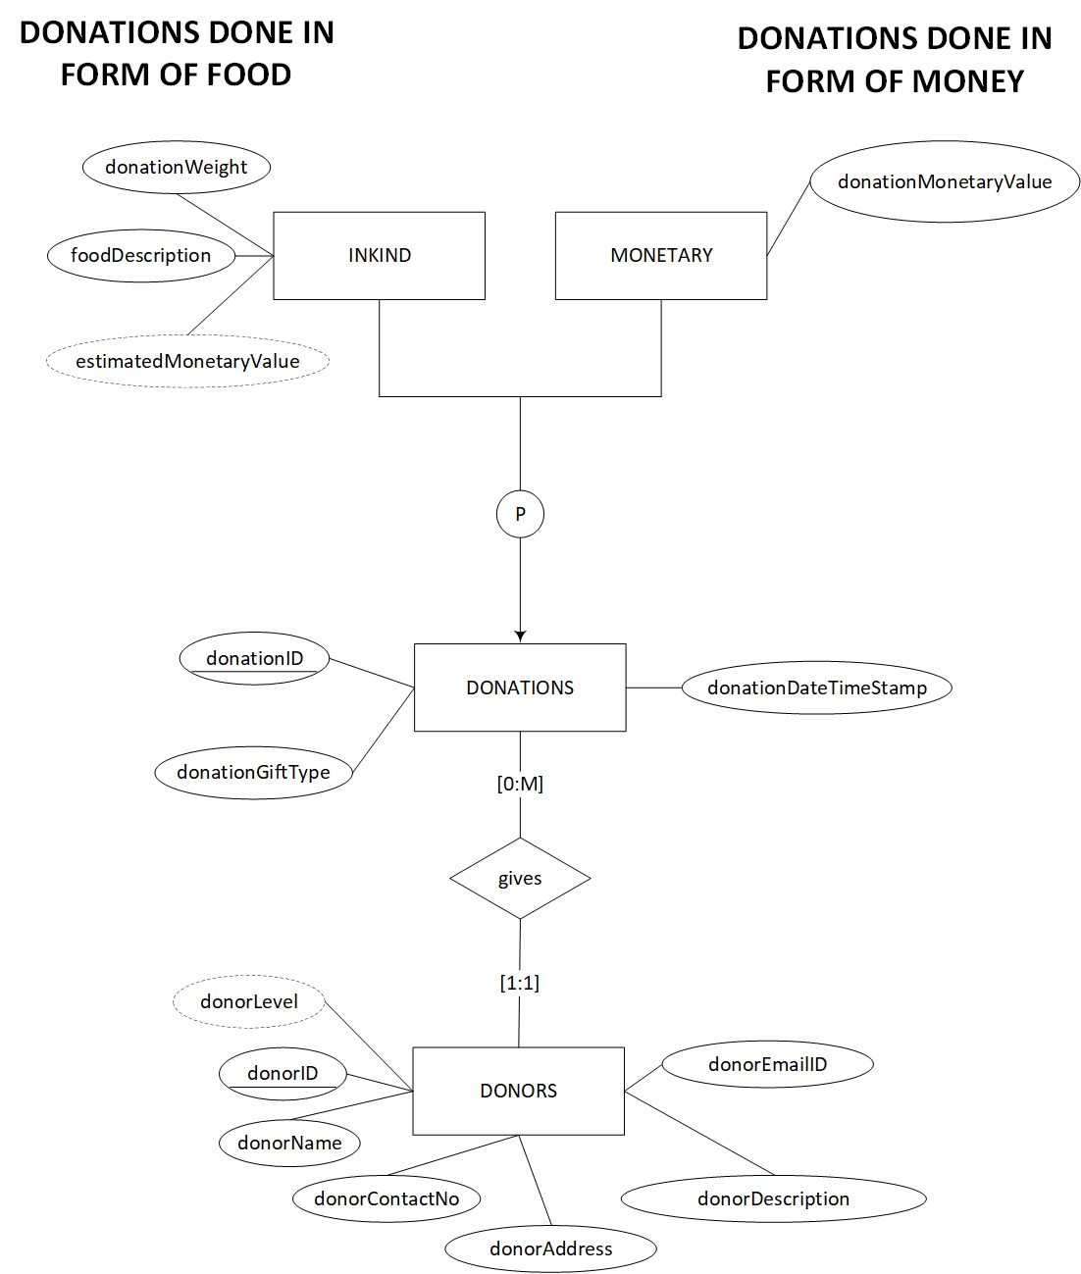
ER Diagram (continued)
DONATIONS DONE IN FORM OF
FOOD
DONATIONS DONE IN FORM OF
MONEY

Slide 9
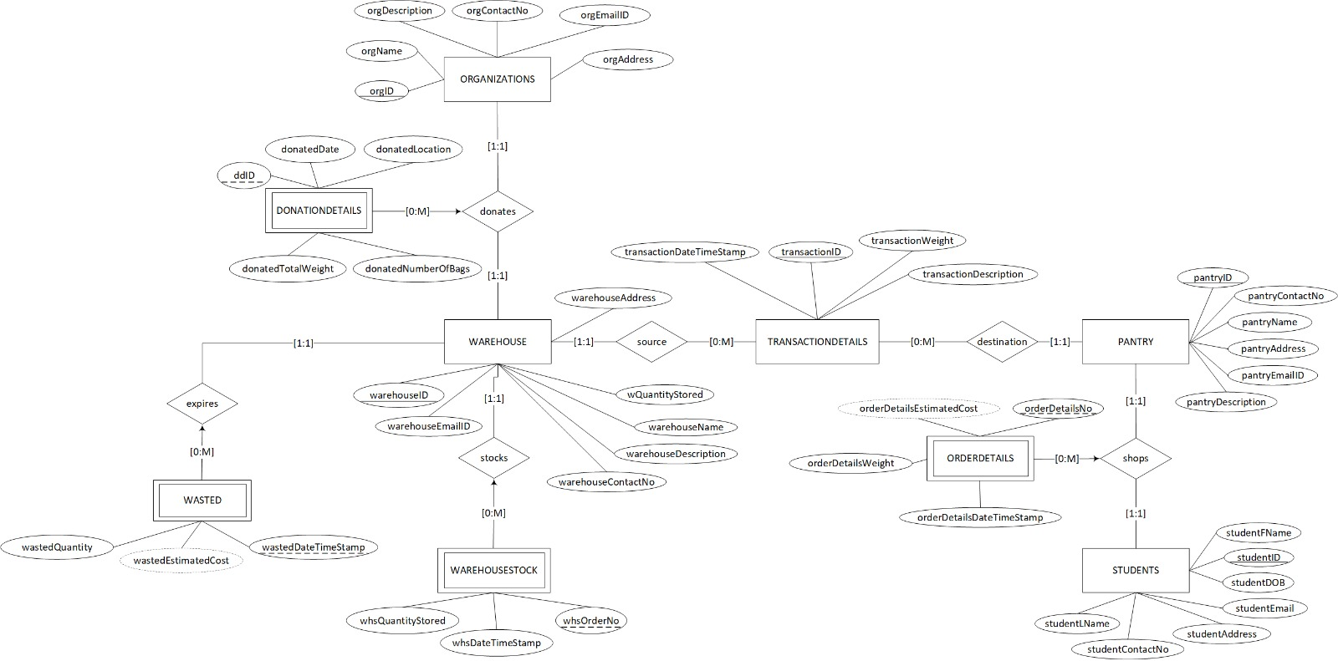
ER Diagram (continued)
FOOD MOVEMENT FROM WAREHOUSE TO ORGANIZATIONS (Donation Details)
FOOD MOVEMENT FROM WAREHOUSE TO PANTRY (Transaction Details)
FOOD WHICH EXPIRES IS WASTED
FOOD MOVEMENT FROM PANTRY TO STUDENT
(Order Details)

Slide 10
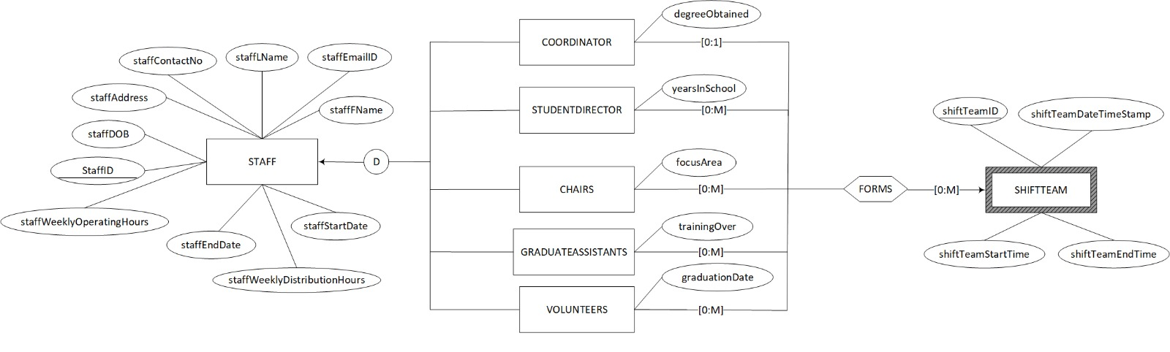
ER Diagram (continued)
STAFF
STAFF CLASSIFIED INTO 5 TYPES AS ABOVE
STAFF COME TOGETHER TO MAKE A TEAM

Slide 11
Relational Design (Normalized Tables)
WAREHOUSE (warehouseID, warehouseAddress,warehouseContactNo,warehouseDescription, warehouseEmailID, warehouseName,wQuantityStored)
PRODUCTS(productID, productDescription, productEstimatedCost, productName, productWeight)
ORDERDETAILS(orderDetailsNo, orderDetailsDateTimeStamp, orderDetailsEstimatedCost, orderDetailsWeight)
PURCHASEORDERS(purchaseOrdersNo, purchaseOrdersDate, purchaseDescription, vendorID)
Foreign Key VendorID references VENDORS
STAFF(staffID, staffAddress, staffContactNumber, staffDOB, staffEmailID, staffEndDate, staffFName, staffLName, staffStartDate, staffWeeklyDistributionHours, staffWeeklyOperatingHours)
SHIFTTEAM (shiftTeamID, shiftTeamDateTimeStamp, shiftTeamEndTime, shiftTeamStartTime)
DONATIONS (donationID, donationDate, donationGiftType, donorID)
Foreign key donorID references DONORS
INKIND(donationID, donationWeight, estimatedMonetaryValue, foodDescription, productID)
Foreign key productID references PRODUCTS
Foreign key donationID references DONATIONS
MONETARY (donationID, donationMonetaryValue)
Foreign key donationID references DONATIONS

Slide 12
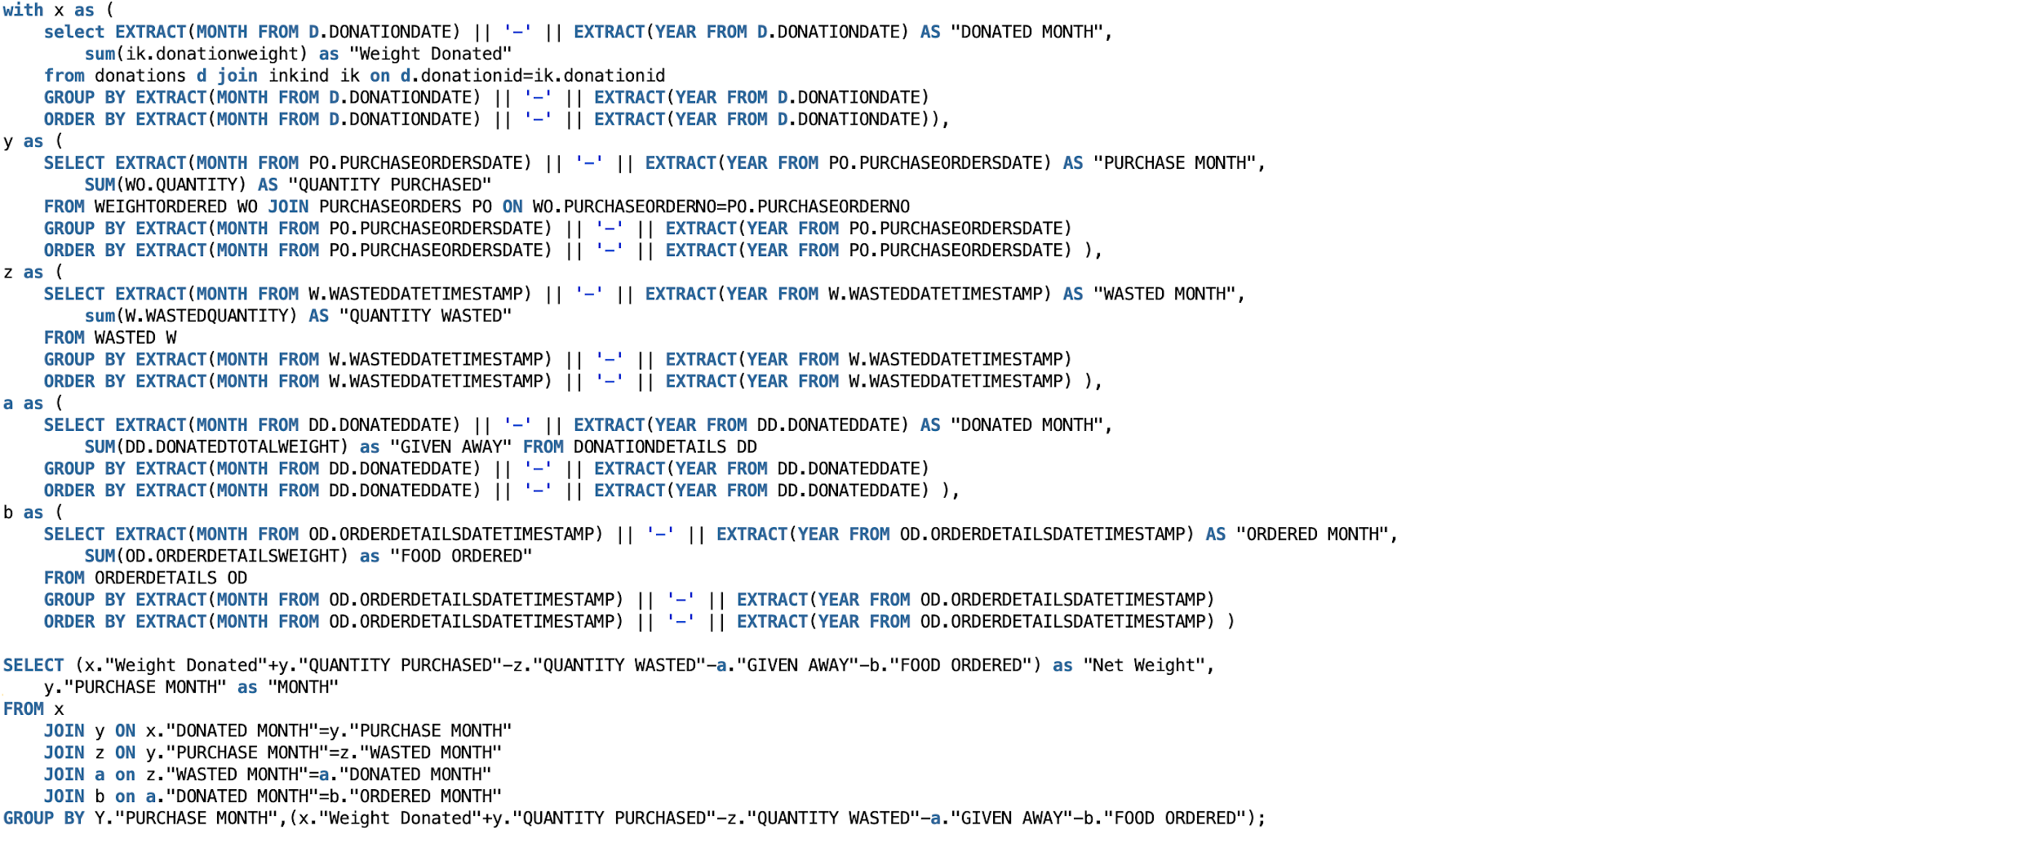
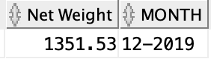
SQL Query 1
AIM: Identify the deficit between total weight of food donated/purchased and total weight wasted/given away
OUTPUT

Slide 13
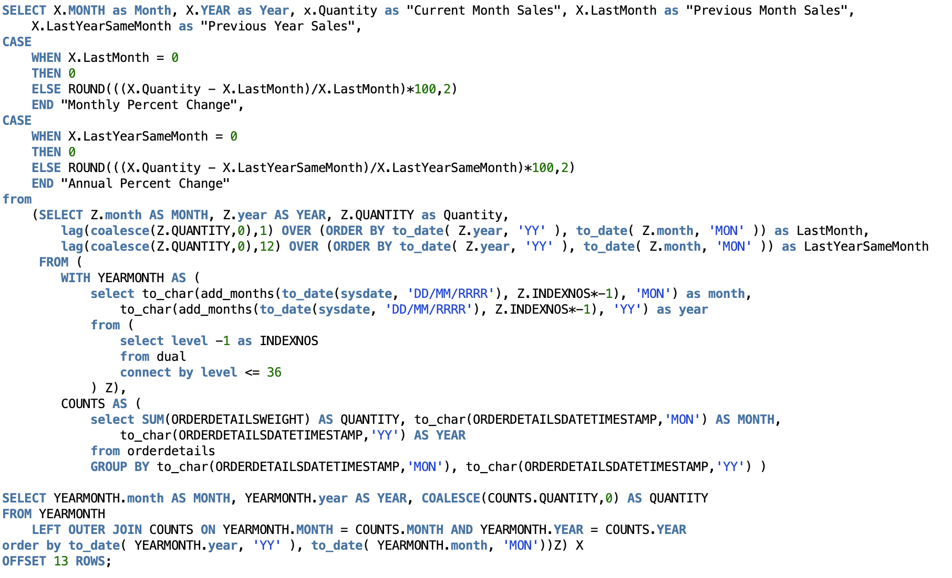
SQL Query 2
AIM: For each month, compare student order details to the previous month and previous year. Calculate monthly and annual percent change.

Slide 14
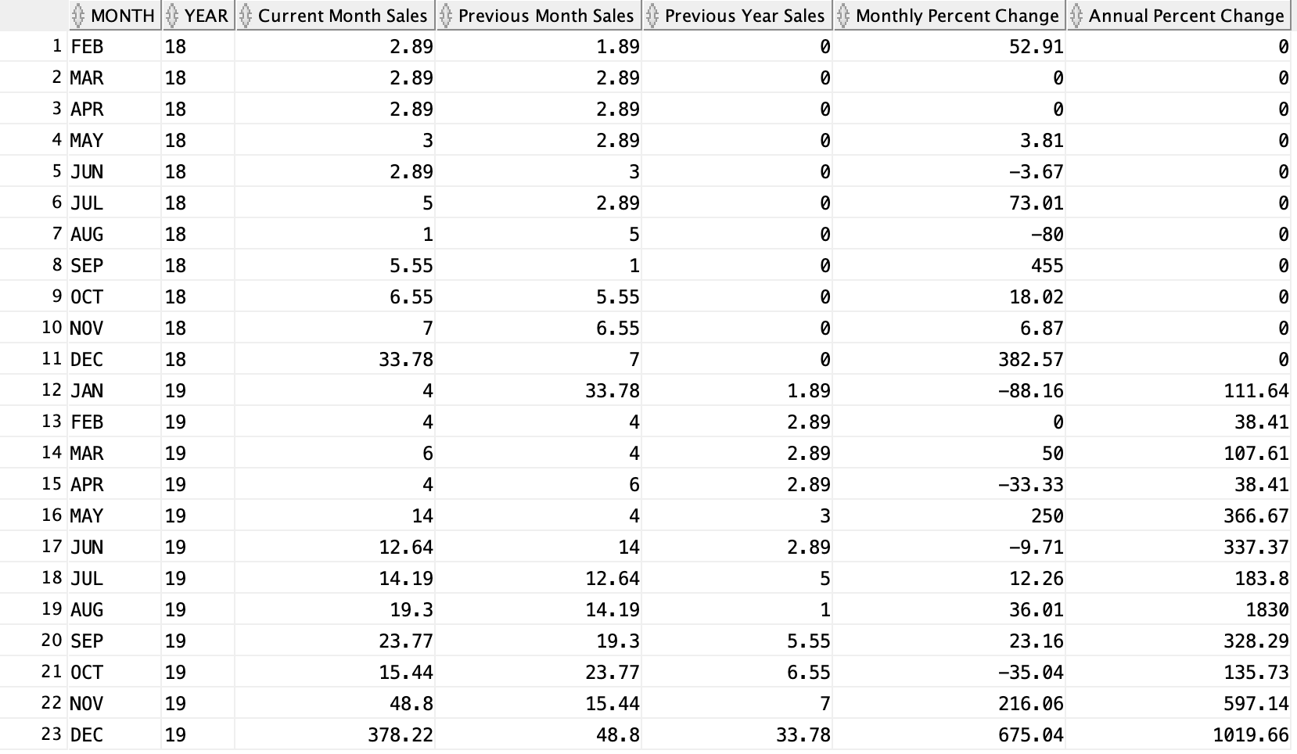
SQL Query 2
OUTPUT

Slide 15
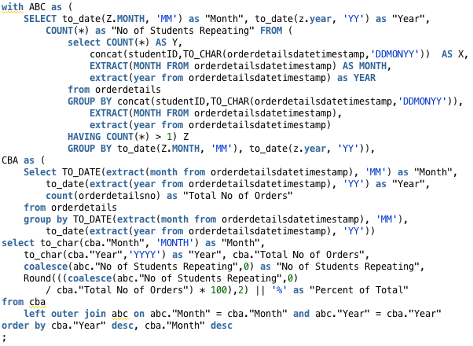
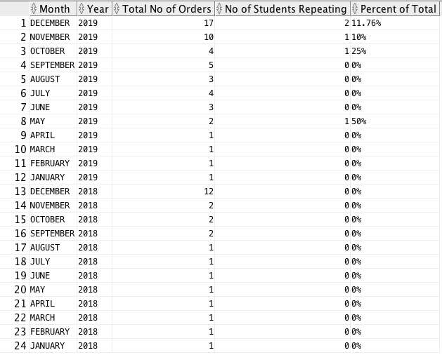
SQL Query 3
AIM: Compare total # of student orders each month to the # of students who have gone to the pantry more than once a day
OUTPUT

Slide 16
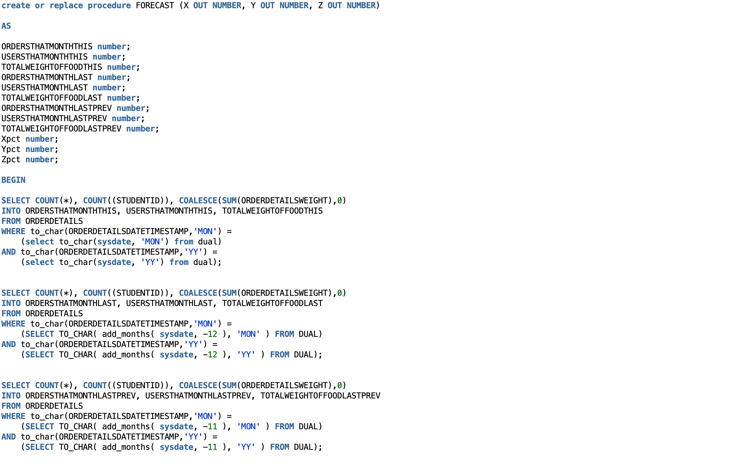
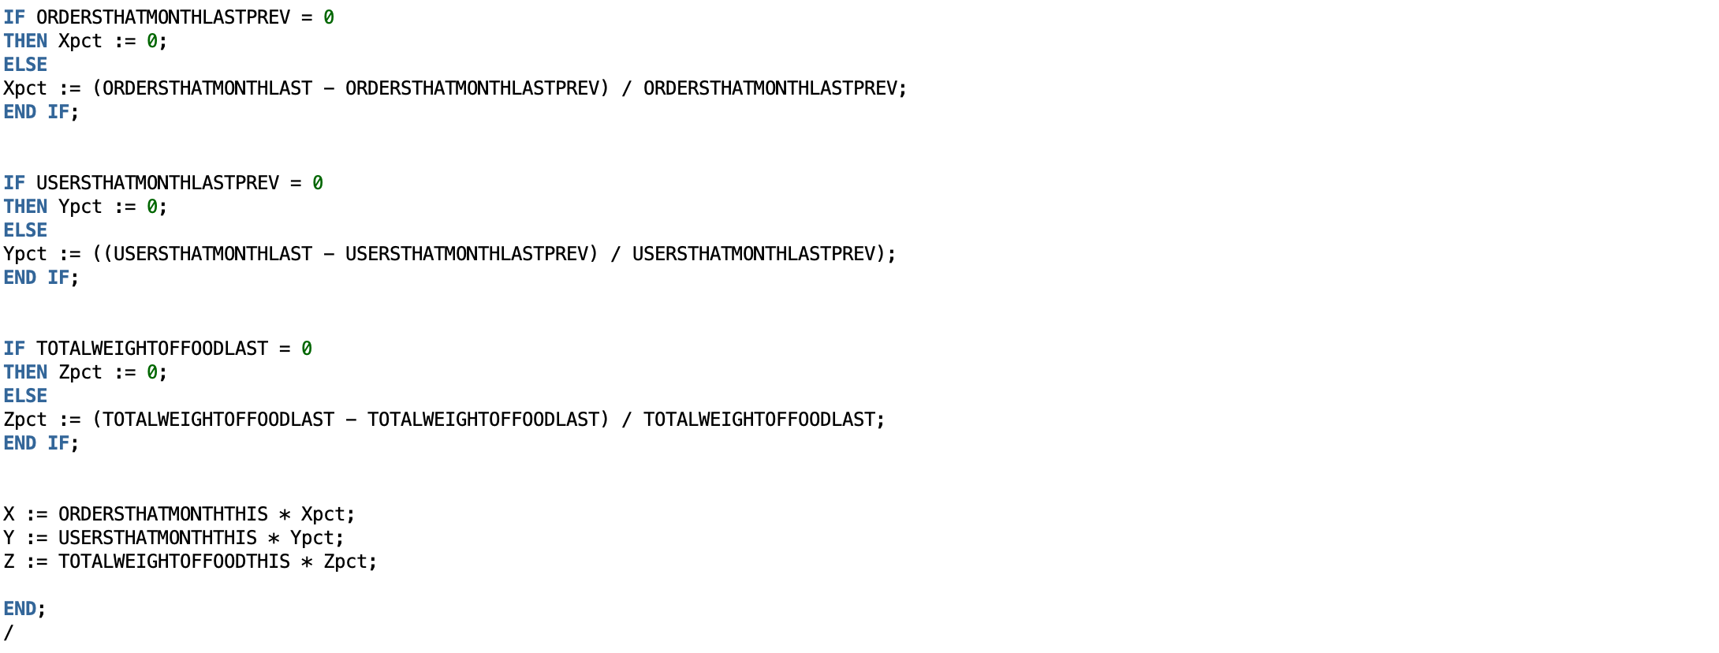
FORECAST Procedure
Identify forecast for # of orders, students, and total weight
Find sum of details for previous month (Nov 2019)
Find details from prior month of previous year (Nov 2018)
Find details from current month of previous year (Dec 2018)
Find difference between months of previous year
Multiply the difference by previous month details to find forecast

Slide 17
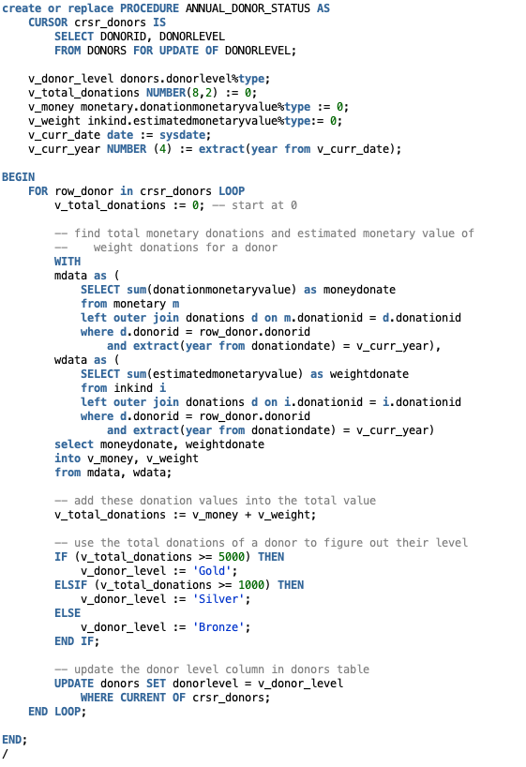
ANNUAL_DONOR_STATUS Procedure
Uses a cursor to loop through all entries in DONORS table
Finds the total number of monetary donations and total estimated value of all “in kind” (food) donations for a donor in the current year
Updates the DONORLEVEL column as Gold, Silver, or Bronze based on the donor’s total amount donated for the current year

Slide 18
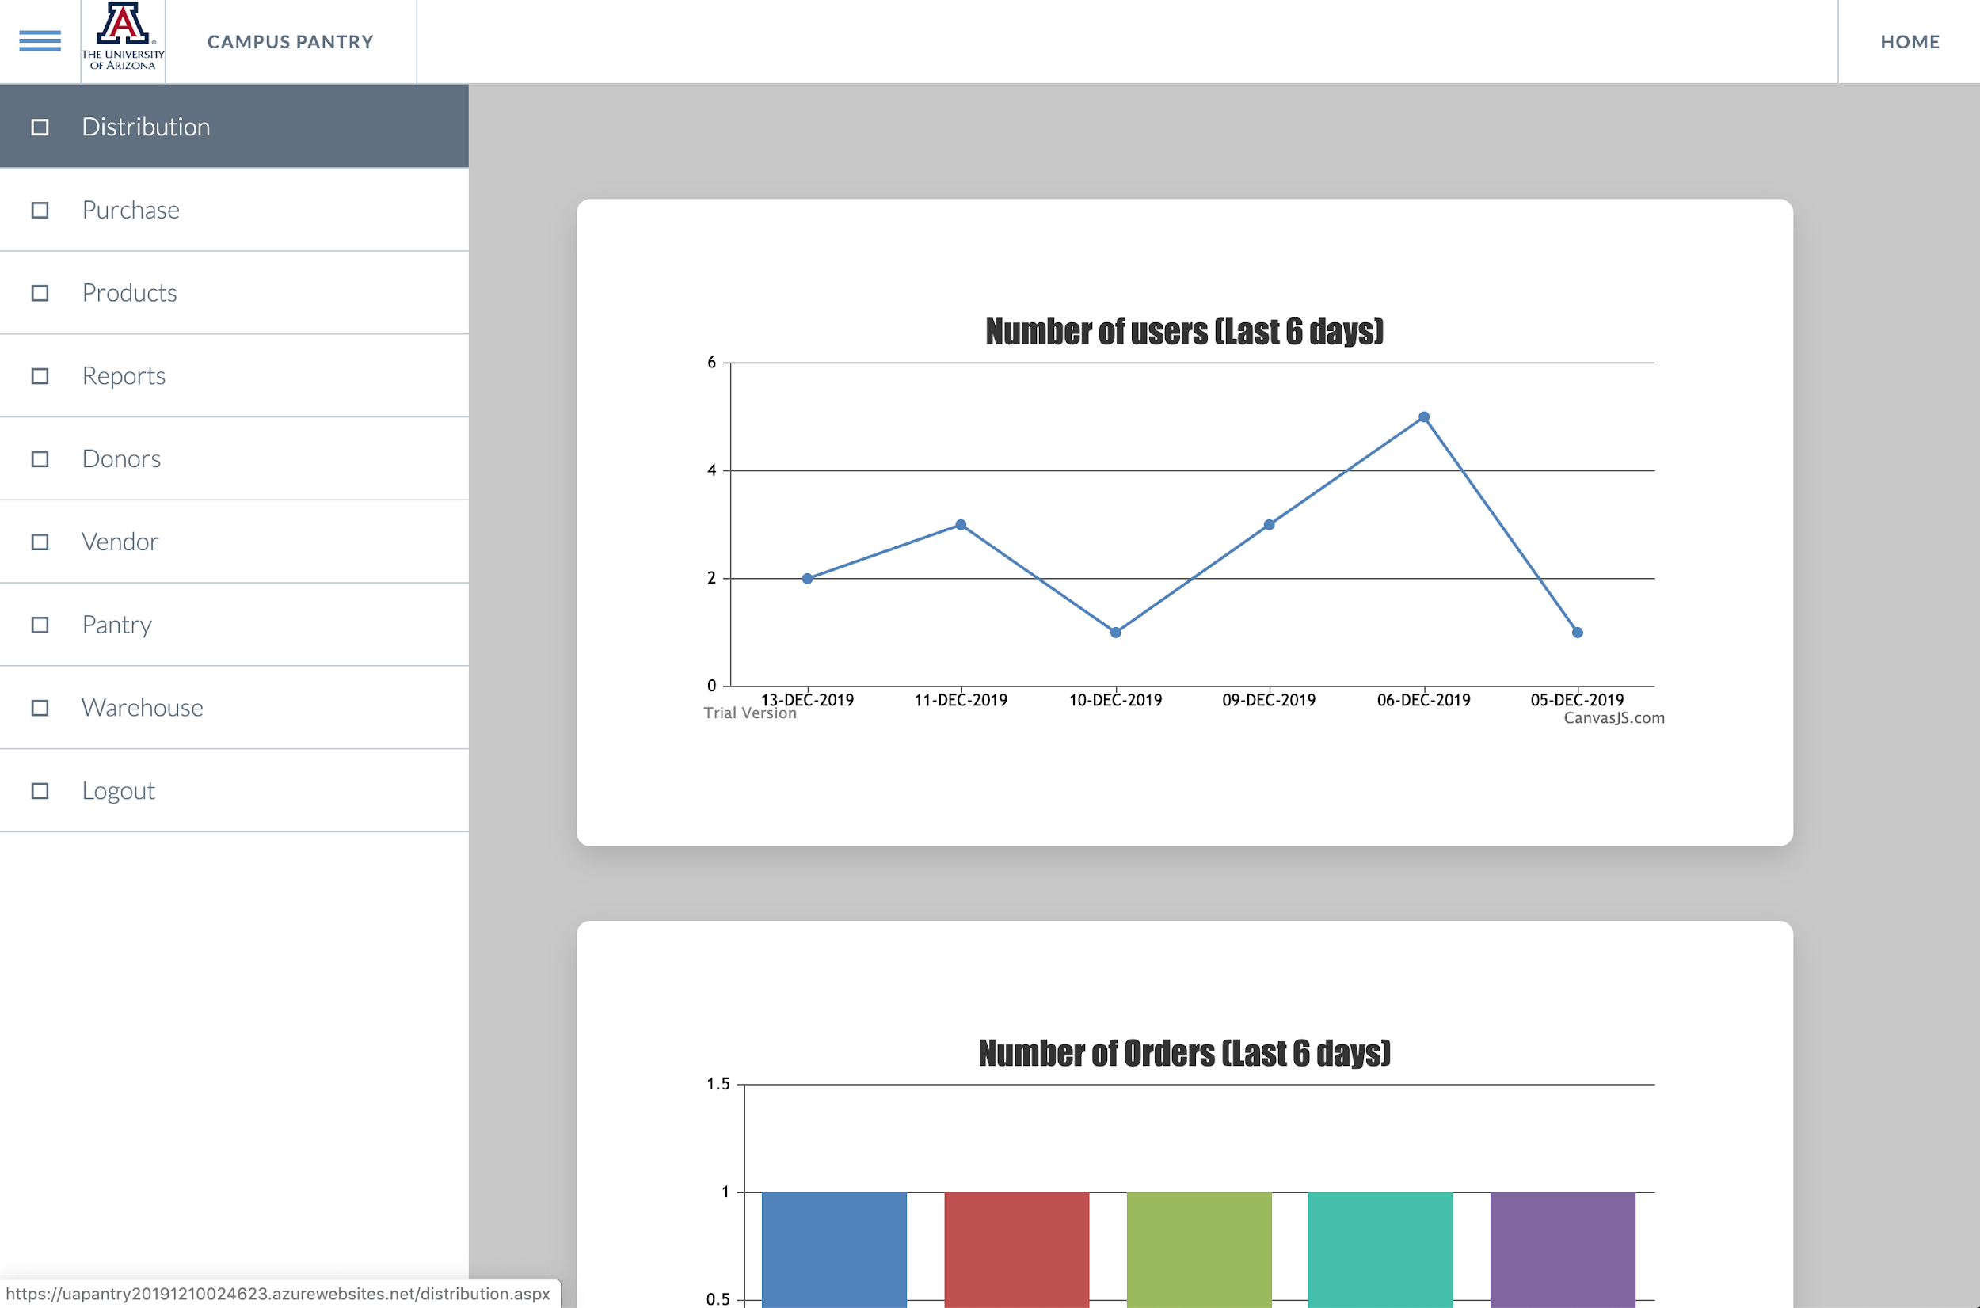
Front-End Demo
https://uapantry20191210024623.azurewebsites.net/Login.aspx

Slide 19
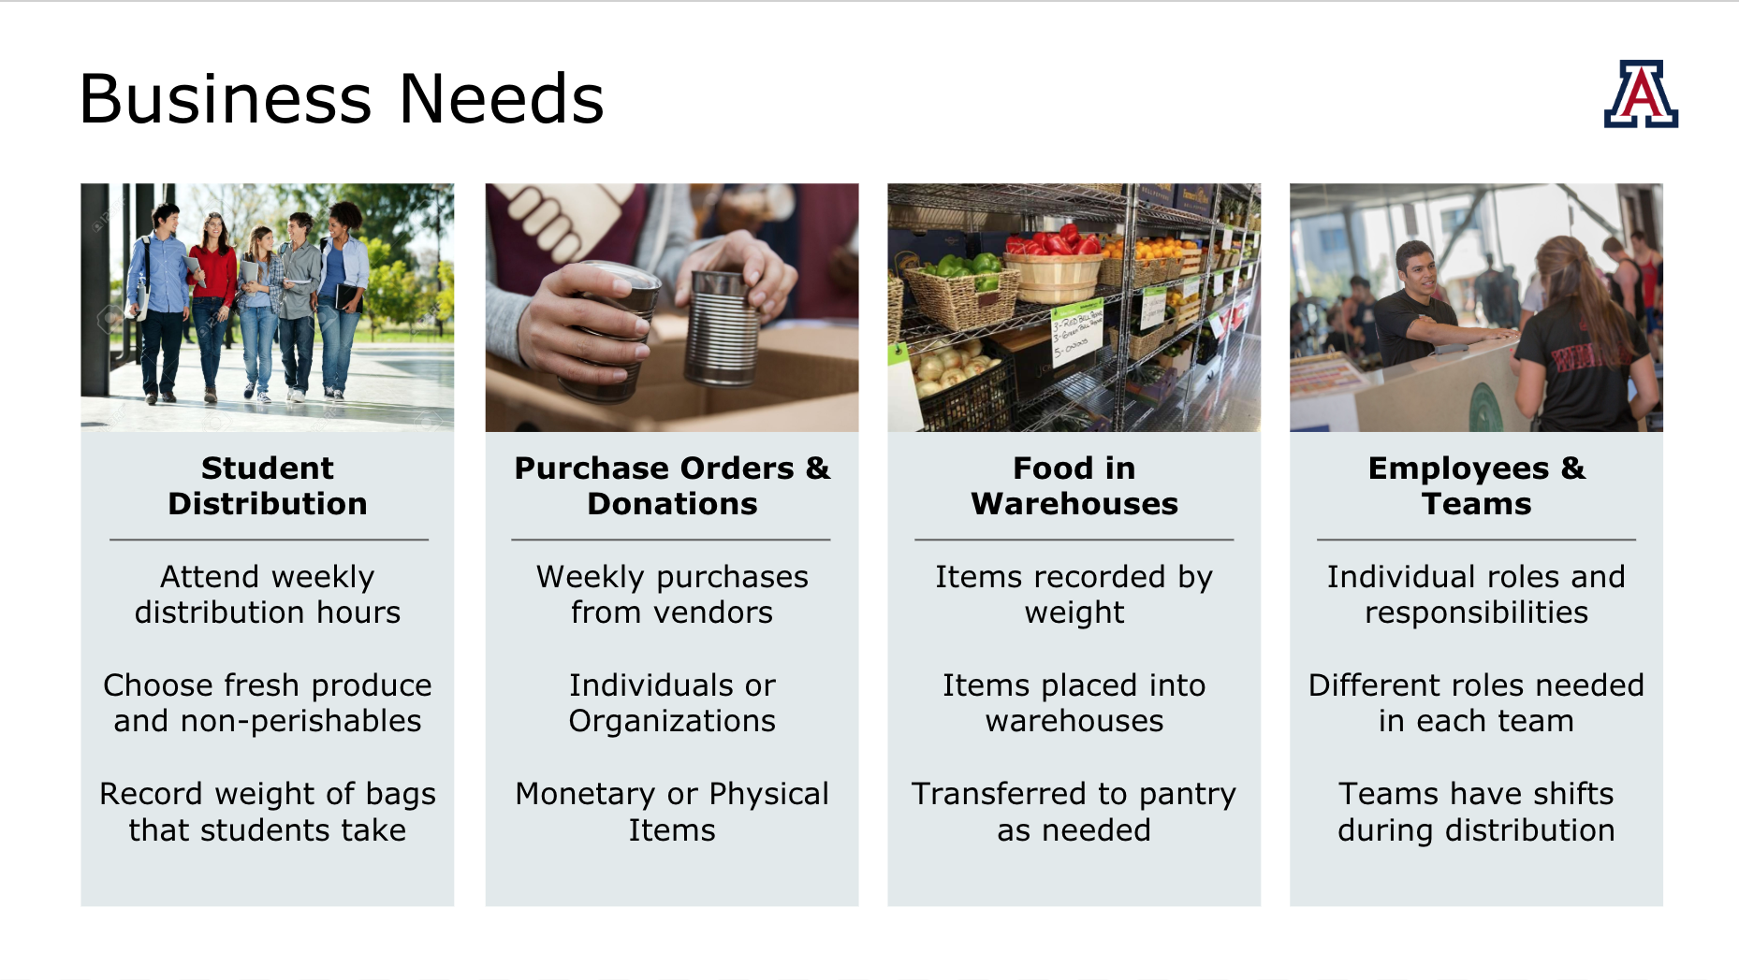
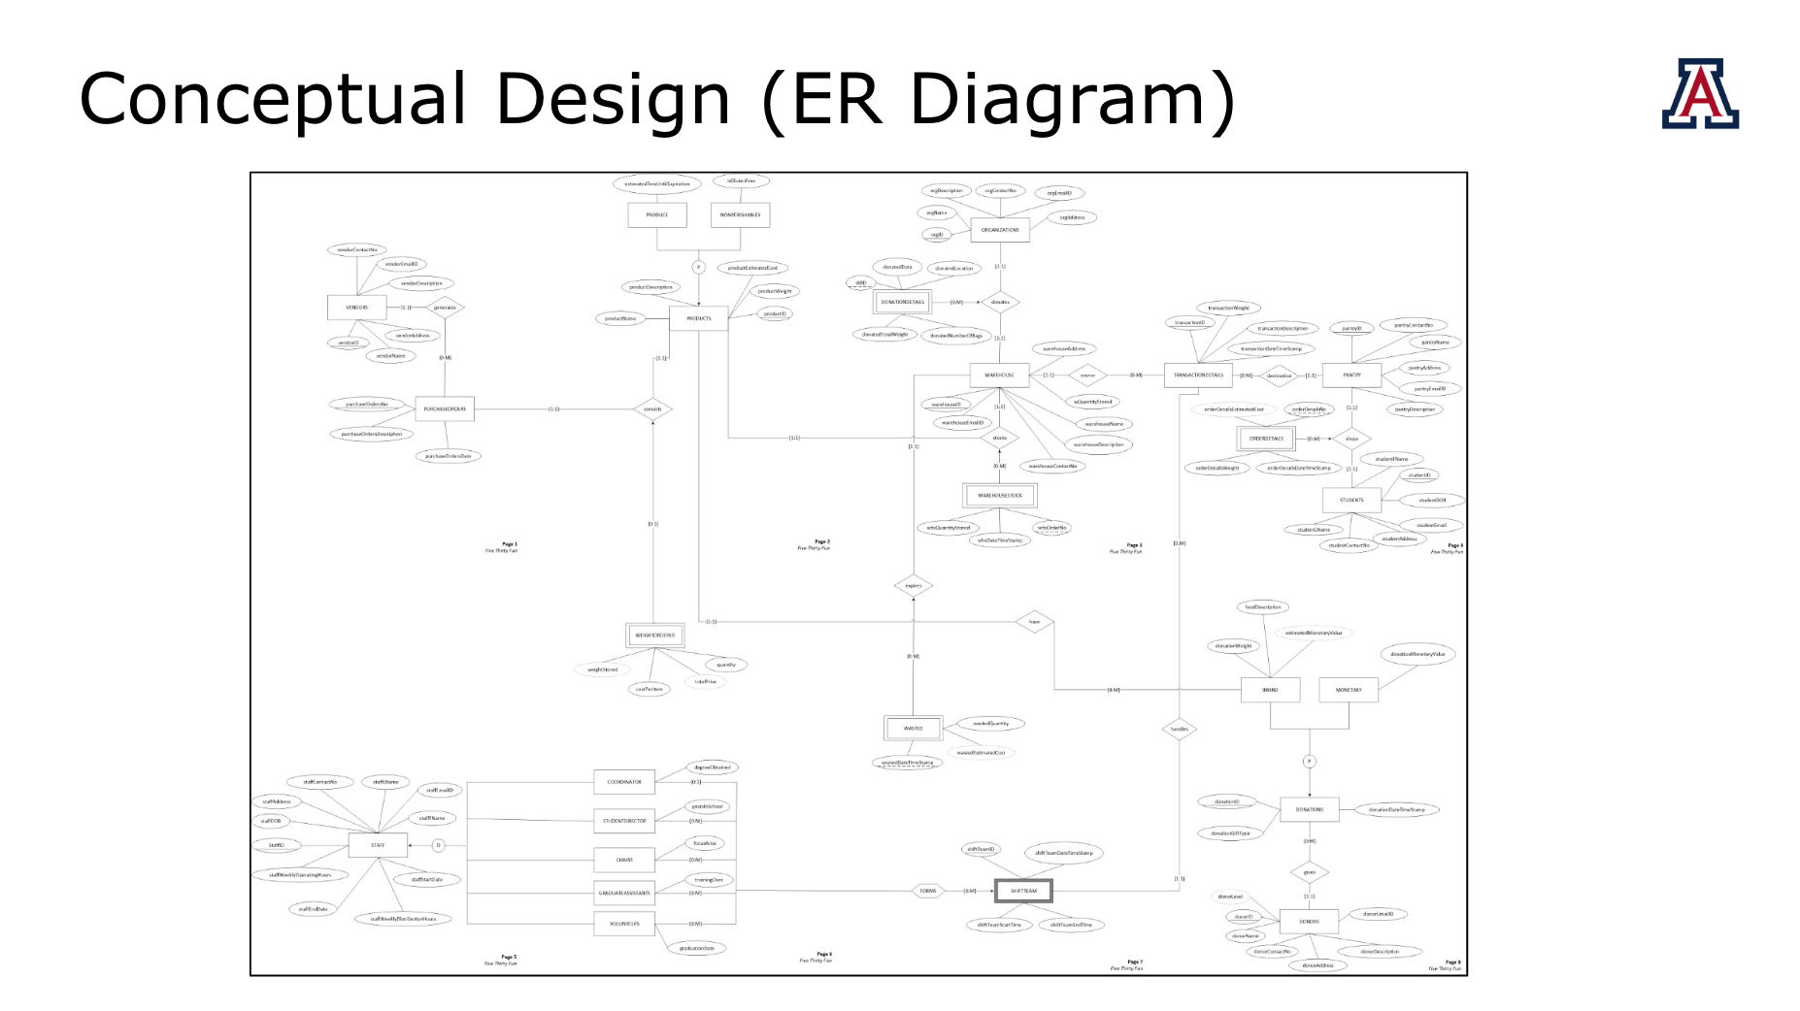
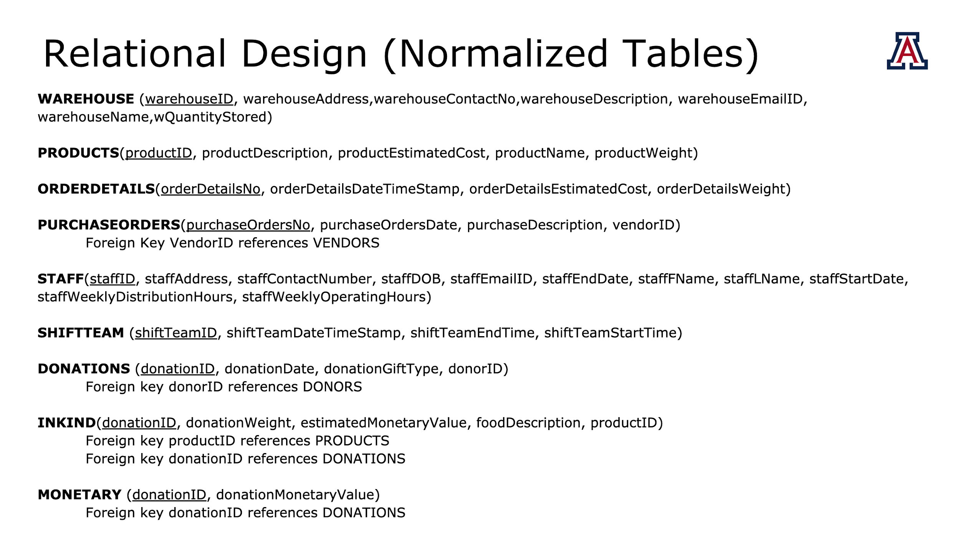
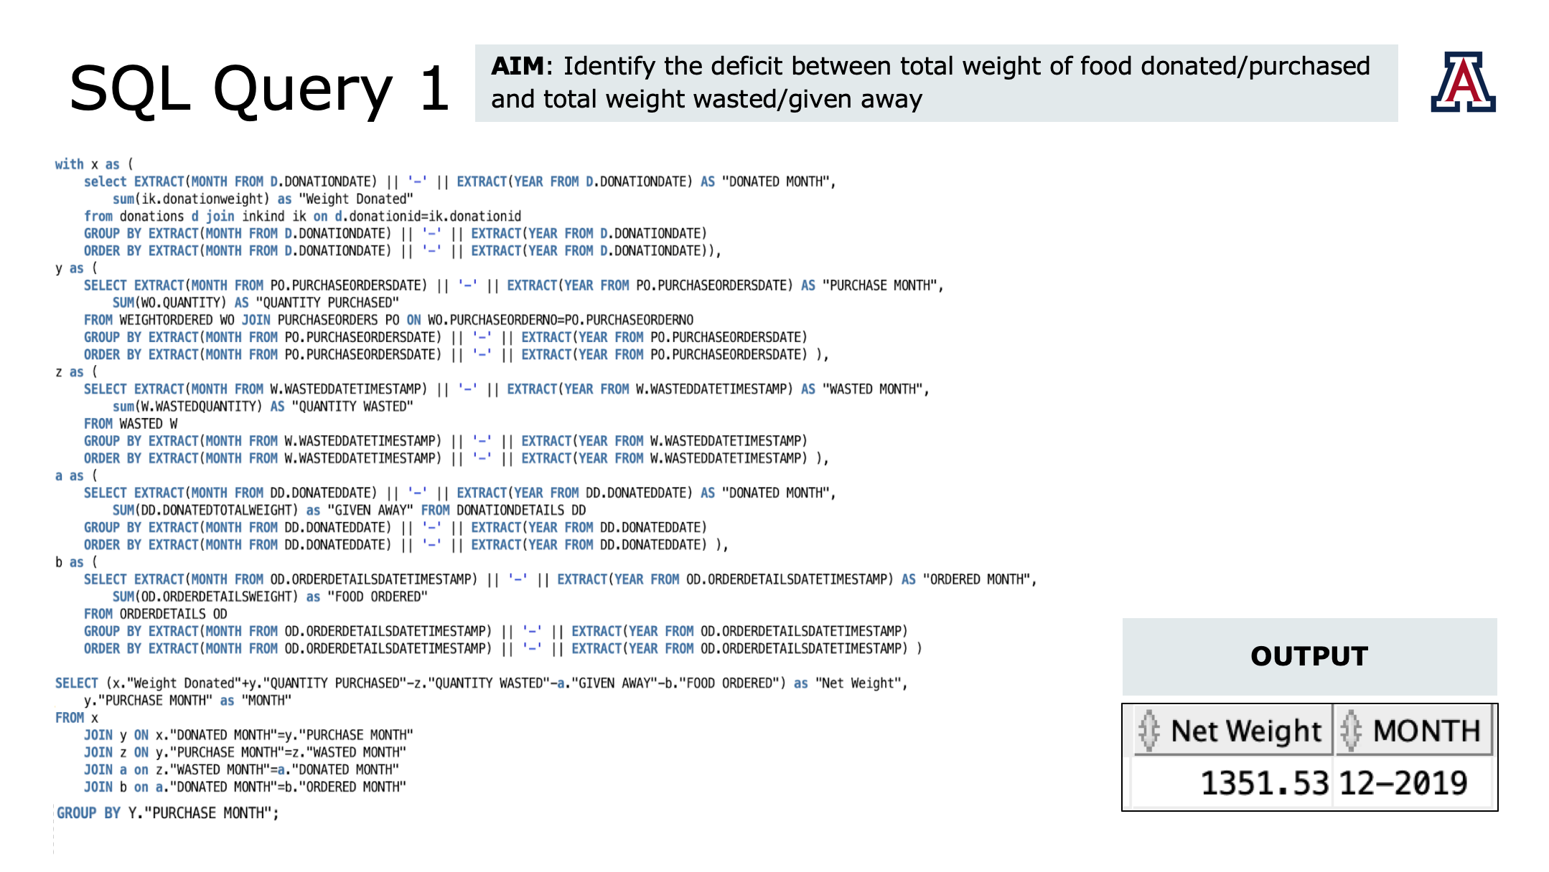
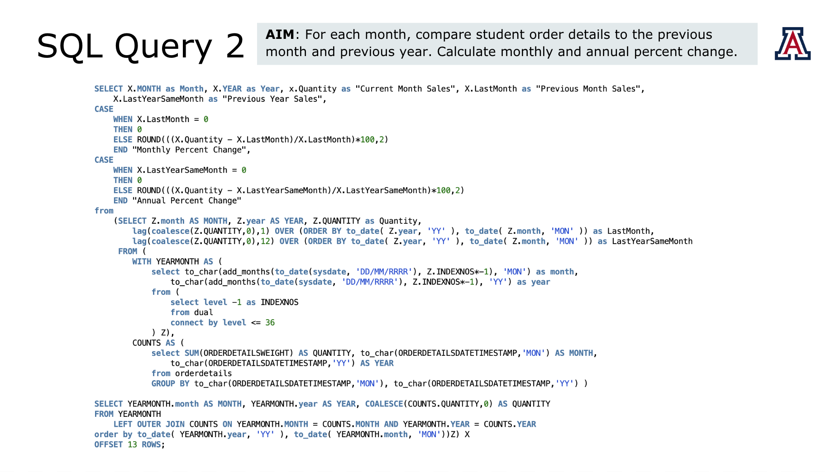
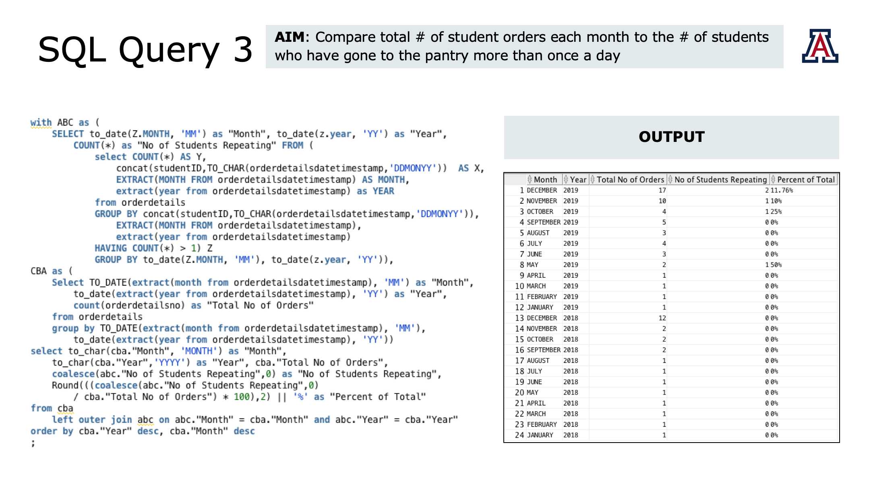
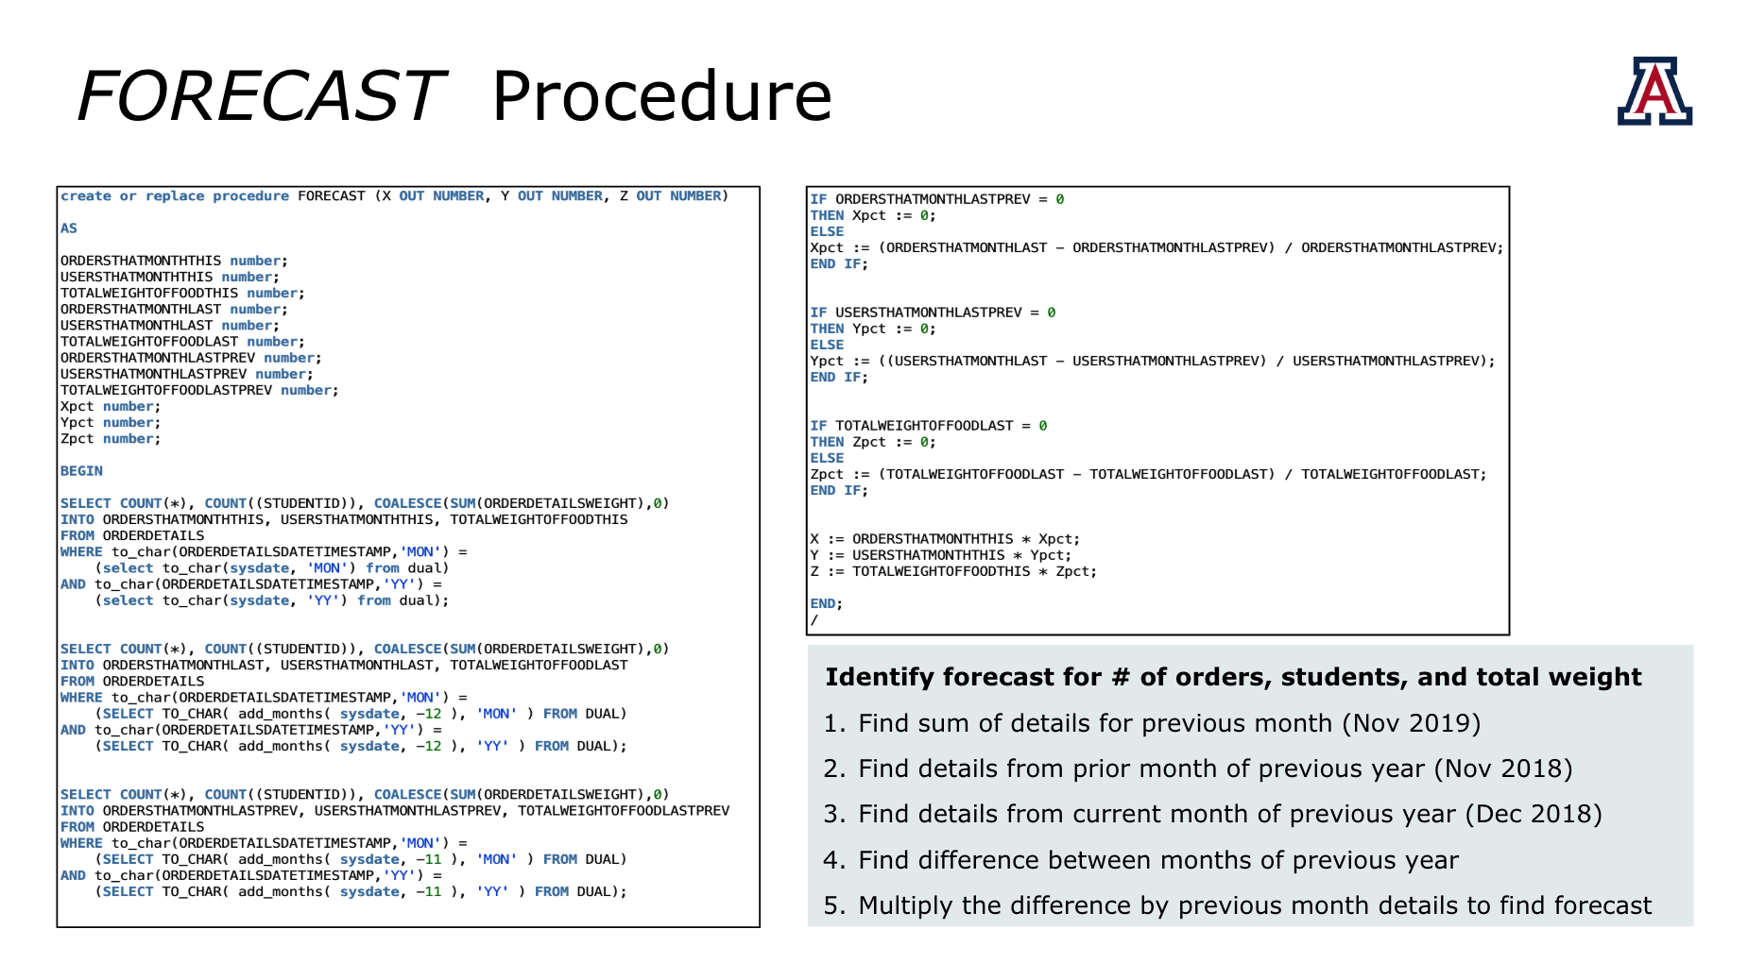
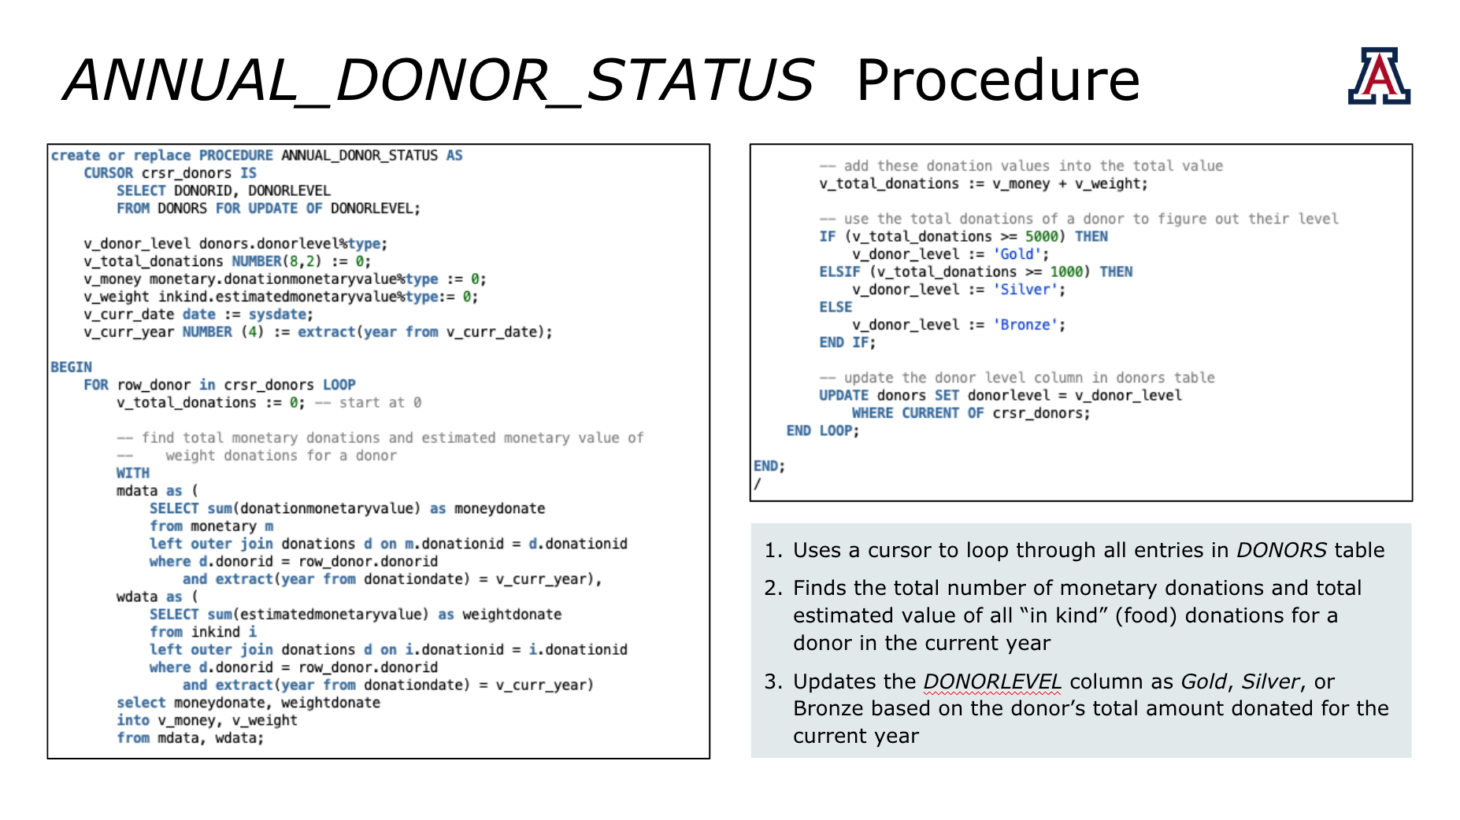
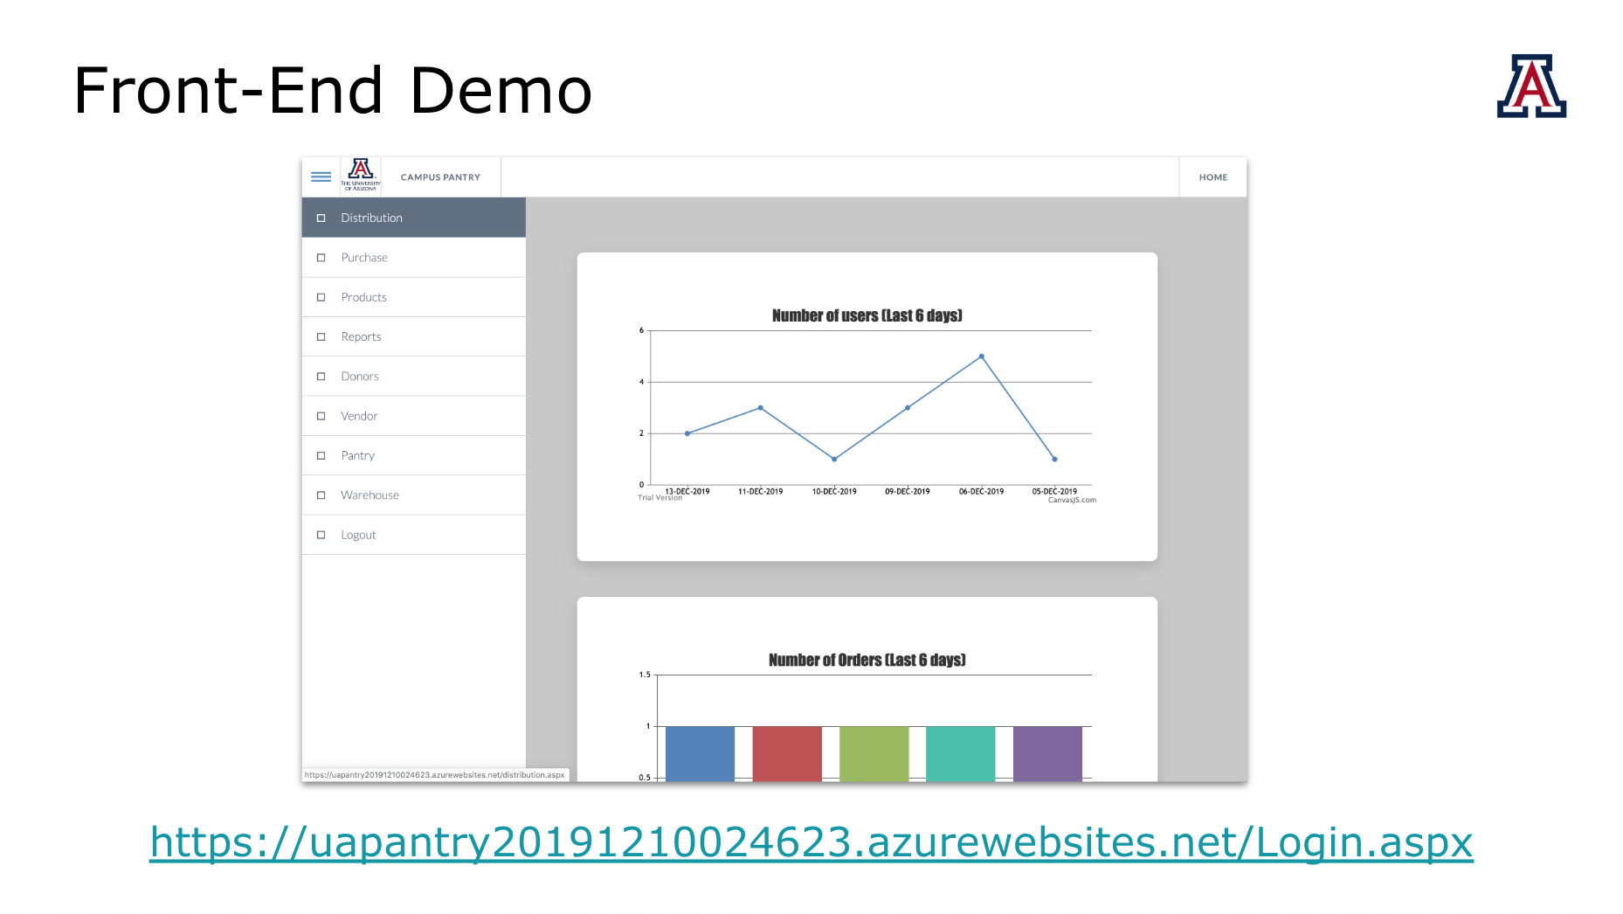
Questions?

Slide 20
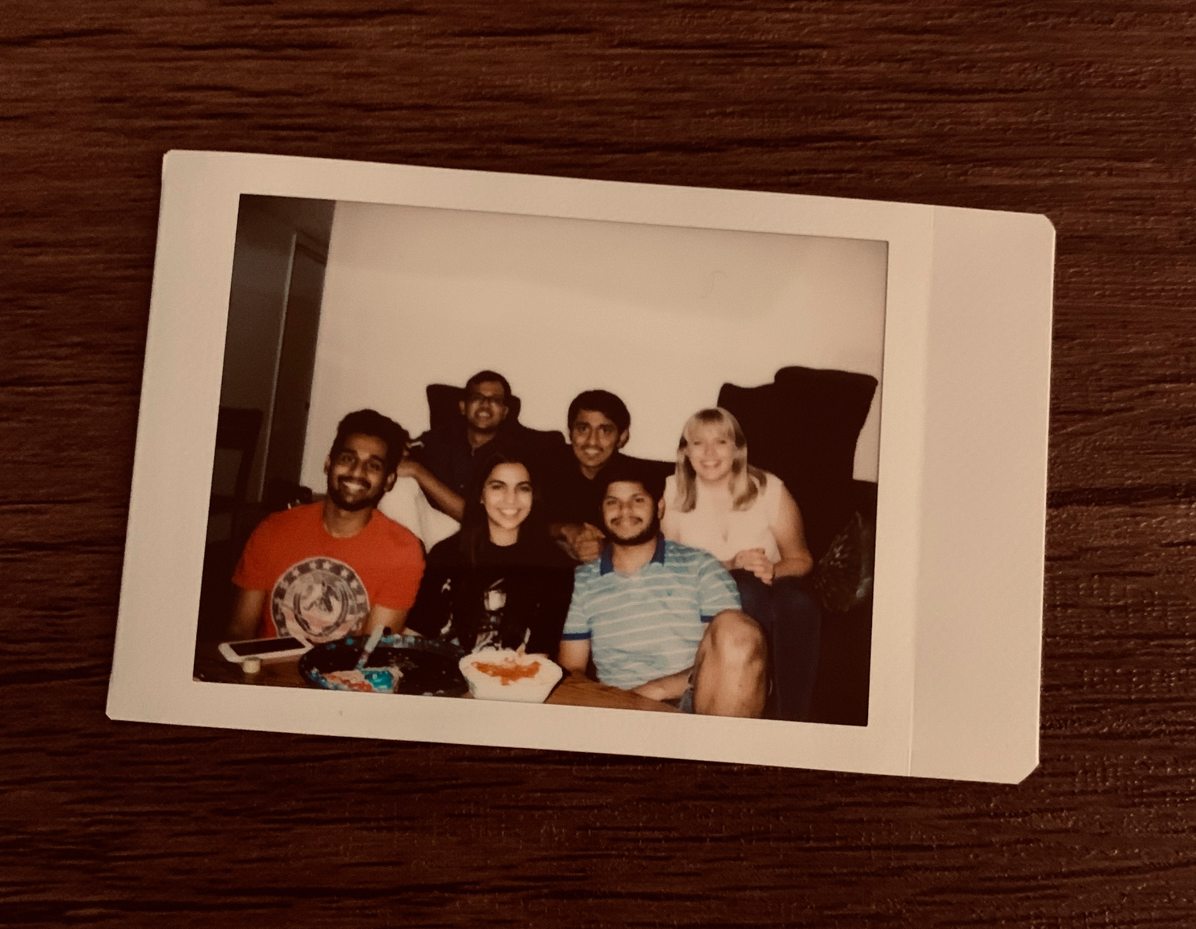
Thank You!

